Slide 1
Waste Classification using Neural Networks
College of Information Science INFO 5082: Seminar in Research and Research Methodologies Dr. Stephen Wheeler
Presented by: Aditya Pitchuka

Slide 2
Agenda
Introduction
Literature Review
Objective of the Study
Data Collection
Exploratory Data Analysis
Methodology for Data Analysis
Convolutional Neural Networks
MobileNet v2
Results
Conclusion

Slide 3
Introduction
Increase in urbanization and economic development around the world has led to increased waste generation.
Waste management is a continuous process of the collection, transport, treatment and disposal of waste.
Recycling is necessary for a sustainable society. The current recycling process requires recycling facilities to sort garbage by hand and use a series of large filters to separate out more defined objects.
Waste products can be classified based on various factors, such as consumption, production, chemical and physical properties to allow for effective reuse and recycling.
Improper waste management will have enormous adverse impacts on the economy, the public health, and the environment.
Effective waste recycling is both economic and environmentally beneficial. It can help in recovering raw resource, preserving energy, mitigating greenhouse gases emission, water pollution, reducing new landfills, etc.

Slide 4
Literature Review
Few researchers have studied the use of CNNs to develop image recognition models for classifying waste. However, there are two examples of waste classifying CNNs.
Gary Thung and Mindy Yang built the CNN “TrashNet” to classify waste into five classes of recyclable content and trash (Thung & Yang, 2017).
SpotGarbage is a mobile application designed by researchers at the Indian Institute of Technology. This app allows users to identify garbage in the street around India’s urban centres (G. Mittal et al., 2016). SpotGarbage uses a CNN called GarbNet, which has been trained on an annotated dataset called Garbage In Images.

Slide 5
Objective of the Study
The objective of this project is to take images of a single piece of recycling or garbage and classify it into six classes consisting of glass, paper, metal, plastic, cardboard, and trash. This is done by learning the features of an image based using Convolutional Neural Networks (CNN).
Expected to get a list of probabilities for all the image categories and we can determine the class based on the high value of probability.

Slide 6
Data Collection
I am using a version of trash image dataset which was created by Gary Thung and Mindy Yang. This is a small dataset and consist of 2527 images, which is divided into six different classes glass, paper, plastic, metal, cardboard all the pictures of the images are of size 512 x 384. I have resized them to 224 x 224 using the scripts they provided.
Dataset Links:
https://github.com/garythung/trashnet
http://drive.google.com/drive/folders/0B3P9oO5A3RvSUW9qTG11Ul83TEE

Slide 7
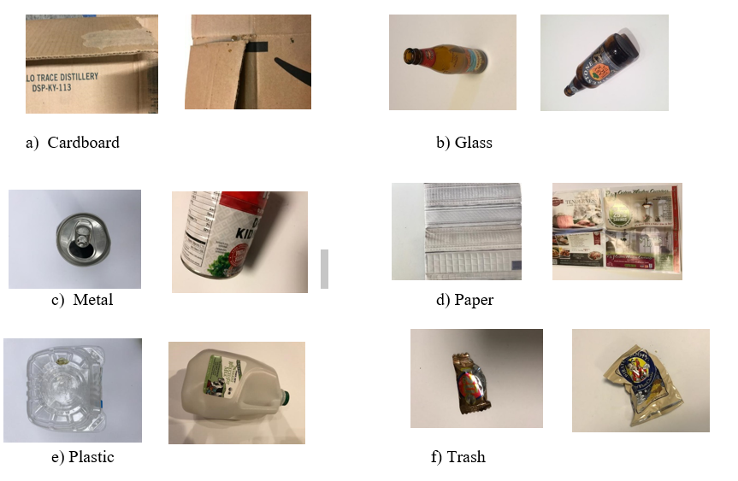
Exploratory Data Analysis

Slide 8
Methodology for Data Analytics
The recent progress in deep learning has contributed to unprecedented improvements in computer vision.
An automated classification mechanism would solve this problem and encourage user engagement as they would not be worried about placing an item in a recycling bin that could possibly contaminate it.
Convolutional neural network (CNN) is one of the most recognized deep-learning algorithms for its wide application in image classification, segmentation, and detection.
CNNs are neural network variants that learn by performing convolutions and have shown stellar performance for image classification tasks. Image classification relies on supervised learning, which requires labeled data to train networks. After the network is trained, it can classify images into discrete classes.

Slide 9
Convolutional Neural Networks
CNNs are widely applied in analyzing visual image. Generally, CNN takes images containing investigated items as inputs and classify images into different categories.
CNN is unique in its 3D volumes of a neuron: width, height, and depth. The CNN consists of a series of convolutional layers, pooling layers, fully connected layers, and normalization layers.
The neurons in the convolutional layer will only connect to a small region of the previous layer. In fully connected layers, the activation neurons of the layer are fully connected to all activation neurons in the previous layer.
The capability of CNN can be controlled by varying dimensional parameters and local architecture structure. In recent years, different CNN architecture variations emerge.
For this project, I’m using a prebuilt CNN model of MobileNet v2 developed by GoogleAI.
To this model, I have flattened the layers and added a Dense layer for classifying 6 Categories.

Slide 10
MobileNet v2
MobileNet v2 is a convolutional neural network architecture that seeks to perform well on mobile devices.
It is based on an inverted residual structure where the residual connections are between the bottleneck layers.
The intermediate expansion layer uses lightweight depth wise convolutions to filter features as a source of non-linearity.
The architecture of MobileNet v2 contains the initial fully convolution layer with 32 filters, followed by 19 residual bottleneck layers.
Source: https://towardsdatascience.com/review-mobilenetv2-light-weight-model-image-classification-8febb490e61c

Slide 11
MobileNet v2 builds upon the ideas from MobileNet v1, using depthwise separable convolution as efficient building blocks. However, v2 introduces two new features to the architecture:
1) linear bottlenecks between the layers, and
2) shortcut connections between the bottlenecks.
Source: https://ai.googleblog.com/2018/04/mobilenetv2-next-generation-of-on.html
The intuition is that the bottlenecks encode the model’s intermediate inputs and outputs while the inner layer encapsulates the model’s ability to transform from lower-level concepts such as pixels to higher level descriptors such as image categories.
Finally, as with traditional residual connections, shortcuts enable faster training and better accuracy.

Slide 12
Python Libraries Used
Developed the CNN model on Google Colab using below python libraries
TensorFlow
Keras -- ImageDataGenerator Adam Optimizer
OS
NumPy
Conv2D
MobileNetv2
sklearn metrics library is used to measure Accuracy and Classification Report.

Slide 13
Results
Running the model, using training data (in batches of 32), for 50 epochs and each epoch taking almost 75 sec to run on Google Colab (on GPU runtime) I got a training accuracy around 90%
Here is a prediction sample for a batch of testing images with the predicted labels with an accuracy of 75%.

Slide 14
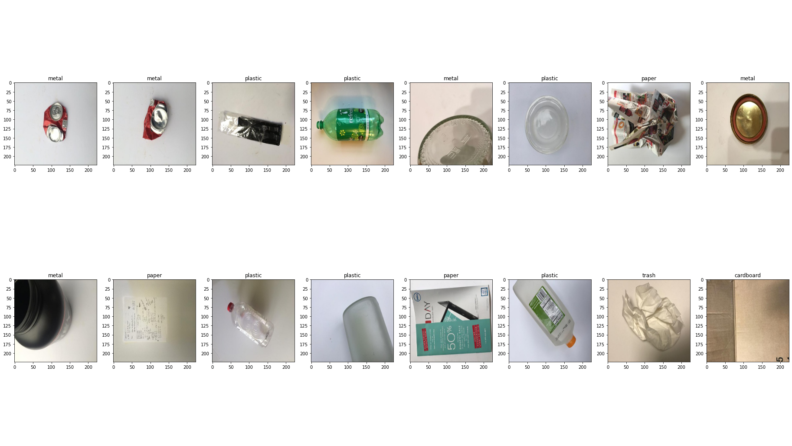

Slide 15
Conclusion
In conclusion, a waste classification system that can separate different components of waste using the Machine learning tools is proposed.
This system can be used to automatically classify waste and help in reducing human intervention and preventing infection and pollution.

Slide 16
Bibliography
D. Hoornweg and P. Bhada-Tata, What a Waste: A Global Review of Solid Waste Management, World Bank, Washington, DC, USA, 2012.
R. E. Sanderson, Environmental Protection Agency Office of Federal Activities’ Guidance on Incorporating EPA’s Pollution Prevention Strategy into the Environmental Review Process, EPA, Washington, DC, USA, 1993.
“The world’s trash crisis, and why many Americans are oblivious,” Apr 2016. [Online]. Available: https://www.latimes.com/world/global-development/ la-fg-global-trash-20160422-20160421-snap-htmlstory.html
Y. LeCun, Y. Bengio, and G. Hinton, “Deep learning,” nature, vol. 521, no. 7553, p. 436, 2015
J. Shihadeh, A. Ansari, and T. Ozunfunmi, “Deep learning based image classification for remote medical diagnosis,” in 2018 IEEE Global Humanitarian Technology Conference. IEEE, 2018, pp. 1–8.
G. Thung and M. Yang, “Trashnet.” [Online]. Available: https://github.com/garythung/trashnet
G. Mittal, K. B. Yagnik, M. Garg, and N. C. Krishnan, “Spotgarbage: smartphone app to detect garbage using deep learning,” in Proceedings of the 2016 ACM International Joint Conference on Pervasive and Ubiquitous Computing. ACM, 2016, pp. 940–945.
N. Johansson and H. Corvellec, “Waste policies gone soft: An analysis of European and Swedish waste prevention plans,” Waste Manag., vol. 77, pp. 322–332, 77 (2018) 322-332.

Slide 17
Thank You

